Slide 1

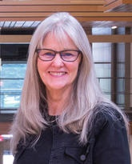
Developing Your Nomination Dossier for UCalgary Teaching Awards
Application Deadline Feb 11, 2021
EXTENDED to MARCH 25, 2021
This PPT includes audio on the slides where the icon is present. Not all slides include audio.
Dr Cheryl Jeffs, EdD
Taylor Institute for Teaching and Learning
November 2, 2020

Slide 2
Introductions & Welcome
Developing Your Nomination Dossier for UCalgary Teaching Awards
Facilitator. Dr. Cheryl Jeffs, EdD
Educational Development Consultant & tenured academic staff
Taylor Institute for Teaching and Learning
Participants
  Award Nominees
  Nominators
  Support for Nominees
  Others

Slide 3
UCalgary Teaching Award Nominations homepage – refer to this often for complete details and any updates
https://taylorinstitute.ucalgary.ca/awards/prepare-nomination-package

Slide 4
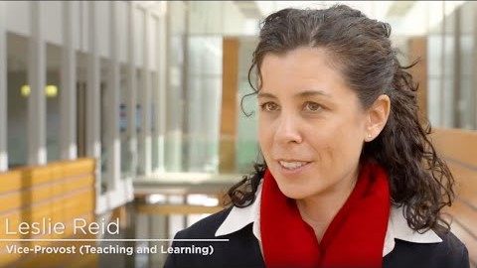
University of Calgary Teaching Awards https://youtu.be/tTiK1o1EUTU

Slide 5
Dossier Requirements
Nomination Deadline
Mar 25, 2021
Refer to your category for specific details
Award Category | Dossier Requirements (evidence) | Philosophy Statement
Award for Continuing and Professional Education | 10-page max, excluding letters of support | 1 page Teaching Philosophy
Award for Curriculum Development | 10-page max, excluding letters of support | Not required
Award for Educational Leadership (Group) | 10-page max, excluding letters of support | 1 page Educational leadership philosophy
Award for Educational Leadership (Individual) | 10-page max, excluding letters of support | 1 page Educational leadership philosophy
Award for Experiential Learning | 10-page max, excluding letters of support | 1 page Teaching Philosophy
Award for Full-Time Academic Staff | 10-page max, excluding letters of support | 1 page Teaching Philosophy
Award for Graduate Assistants (Teaching) | 10-page max, excluding letters of support | 1 page Teaching Philosophy
Award for Graduate Supervision | 10-page max, excluding letters of support | 1 page Graduate supervision philosophy
Award for Librarians, Archivists and Curators | 10-page max, excluding letters of support | 1 page Teaching Philosophy
Award for Non-Academic Staff (Group | 10-page max, excluding letters of support | 1 page Philosophy statement
Award for Non-Academic Staff (Individual) | 10-page max, excluding letters of support | 1 page Philosophy statement
Award for Sessional Instructors | 10-page max, excluding letters of support | 1 page Teaching Philosophy
Award for Teaching in Online Environments | 10-page max, excluding letters of support | 1 page Teaching Philosophy
Award for Team Teaching | 10-page max, excluding letters of support | 1 page Teaching Philosophy
Award for Workplace-Integrated Education | 10-page max, excluding letters of support | 1 page Teaching Philosophy

Slide 6
Developing Your Nomination Dossier for UCalgary Teaching Awards
D2L Content Overview
(this course will be open till the application deadline)
Award Category
Guides your focus
and content
Dossier Requirements
Getting Started
Philosophy Statement
Putting it together
Your Dossier (evidence)
Nomination Package
Deadline March 25, 2021

Slide 7

How should I structure my nomination package?
The elements of the nomination package should be presented in the order they appear in the call for nominations and the requirements of your specific Award category:
Cover page (online template)
Nomination letter (2 pages)
Philosophy statement (1-page)
Evidence based on the perspectives of others (Dossier – max 10 pages excluding letters)
Letters of support

Slide 8
Philosophy Statement (1 page). Refer to your category for specific details.
What your fundamental values and beliefs are
Why you hold these values and beliefs
How you translate these values and beliefs into practice
Types of Philosophy Statements
Teaching
Educational Leadership
Graduate Student Supervision
Other

Slide 9

Creating your Philosophy Statement
1. Identify which type of philosophy statement is required for your category
2. Develop a 1 page philosophy statement of your values and beliefs. Review statements at https://taylorinstitute.ucalgary.ca/resources/sample-teaching-philosophy-statements
Source. Colourbox Dizanna

Slide 10
Creating your Philosophy Statement
Resources and worksheets how to get started are included in D2L
Taylor Institute Website Resources. https://taylorinstitute.ucalgary.ca/resources/teaching-philosophies-and-dossiers
Source. Colourbox Dizanna

Slide 11
Components of a Dossier (evidence)
Refer to your Award Category for detailed criteria to include in your nomination dossier
Find a mentor, colleague, someone to review your dossier. Check if your dept or faculty has a communications department to help you.

Slide 12


Thank you for participating
Ongoing Registration for this course https://conted.ucalgary.ca/search/publicCourseSearchDetails.do?method=load&courseId=50809748&expandSectionId=56633167&parentSite=TI
Access to the D2L site will be open until March 25, 2021
                Contact me cljeffs@ucalgary.ca
                Cheryl Jeffs

